Slide 1
Introduction to Python Programming
moyin.dev – AI & Data Science Bootcamp
Class 2: Setting Up & Writing Your First Program

Slide 2
Class Objectives
1
2
3
4
5
6
AI|DS Bootcamp
moyin.dev
Set up a Python development environment using VS Code and Google Colab
Understand basic Python syntax and structure
Use variables to store and manage data
Identify and work with common Python data types
Apply conditional statements to control program flow
Write and run their first Python program

Slide 3
What Is Python?
AI|DS Bootcamp
moyin.dev
Python is a high-level programming language, Easy to read and beginner-friendly Widely used in:
- AI & Machine Learning - Data Science - Web Development - Automation
Focuses on clarity and simplicity

Slide 4
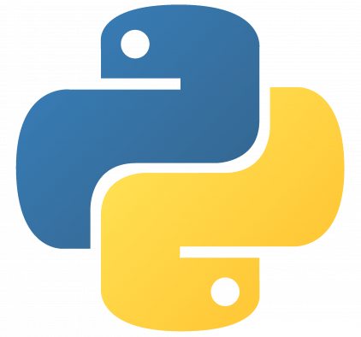
Why Python for AI & Data Science?
AI|DS Bootcamp
moyin.dev
Simple syntax → faster learning, Large ecosystem of libraries:
- NumPy - Pandas - Matplotlib - Scikit-learn - Strong community support - Industry-standard

Slide 5
What Is a Variable?
AI|DS Bootcamp
moyin.dev
A variable is a container that stores information in your program. Think of it like a labeled box:
The label is the variable name (e.g., age, name)
What's inside the box is the value (e.g., 20, "Alex")
You can change what's inside anytime Variables let your program remember and use information.

Slide 6
What Are Data Types?
AI|DS Bootcamp
moyin.dev
Data types tell Python what kind of information you're working with. Just like in real life, different types of information behave differently:
Integer (int): Whole numbers without decimals, e.g 5, 100, -3, 0
Float (float): Numbers with decimal points, e.g 3.14, 2.5,`-0.99, 10.0
String (str): Text or characters - Always wrapped in quotes e.g "Hello", 'Python', “123”
Boolean (bool): True or False - Used for yes/no questions and conditions

Slide 7
What Are Conditionals?
AI|DS Bootcamp
moyin.dev
Conditionals let your program make decisions. Think of it like a fork in the road: - IF something is true → go this way - ELSE → go that way
Conditionals make your programs smart and responsive.

Slide 8
Code editor
Setting Up Your Environment
Online coding environment
AI|DS Bootcamp
moyin.dev
VS Code (local setup)
Google Colab (online)

Slide 9
Requirements
VS Code (Visual Studio Code)
AI|DS Bootcamp
moyin.dev
A lightweight code editor by Microsoft Supports many programming languages Features:
Syntax highlighting
Extensions
Integrated terminal
Install Python
Install VS Code
Install Python extensions

Slide 10
Google Colab
AI|DS Bootcamp
moyin.dev
Cloud-based Python environment
Runs entirely in the browser
No installation required
Ideal for beginners and quick experiments

Slide 11
Your first Python Program
Hello World
AI|DS Bootcamp
moyin.dev

Slide 12
Hands-on Workshop
AI|DS Bootcamp
moyin.dev

Slide 13
Questions?
AI|DS Bootcamp
moyin.dev

